Slide 1
Academic Pathway Optimization
By Group: Goodfellas

Slide 2
Members and Roles
Tanner Yatsko (Project Manager, Database Developer)
Paul Lyon (UI Developer, Front-End Developer, Presenter/Marketer)
Jas Singh (Product Manager, Presenter/Marketer)
Zach Jaquet (Front-End Developer)
Ben Wang (Business Analyst)
Densu Kurian (Business Analyst)
William Chanmugam (UI Developer)
Niels Verhoeven (Full-Stack Developer)

Slide 3

Overview of Project
College students have a hard time deciding
what major and academic programs they want to select.
Using multiple inputs such as interests, desired course load, desired income level, and difficulty, students can be provided with optimal majors and general requirement courses that best fit their preferences.
Students will also be provided with the courses and professors that give them the highest probability of graduating.

Slide 4

Project Sponsor
Organization: University of Maryland, Baltimore County (UMBC)
Address: 1000 Hilltop Circle, Baltimore, MD 21250
Phone: (410) 455-1000
Email: admissions@umbc.edu

Slide 5
Systems Request
Business Opportunity:
A service/application can be developed that can provide a more personal look into offered majors, course paths, and associated difficulties. It can get a feel for what a student wants and likes about certain programs to allow them to decide for themselves. Providing this type service will be able to take loads of work off of school staff.

Slide 6
Systems Request
Business Objectives:
It is the full intention to provide the student with an interactive application that allows the student to ask questions, research, and map out a major/minors that is right for them and also provide them with the direction on how to complete the associated programs. With this application showing which courses would be recommended for the students to select the easiest, yet most rewarding course path.

Slide 7
Systems Request
Background:
Students looking to continue their education into college must decide on a major/minors, selecting course paths in order to graduate in a reasonable timeframe. UMBC Admissions Office provides a service in helping students select those majors and also the course paths. While these services are offered, students also have their motives as to the majors they would consider (interests, potential salary, difficulty, etc.).

Slide 8
System Request Cont.
Project Sponsor: UMBC’s systems finance department
Business need: Increase access to information and give students a resource to see what is best for them
Business Requirements: Capture student demographics and include search capabilities for each field
Business Value: Reduction of people switching majors, reduction of “undecided” majors, Increase in graduation rate, decrease in debt of students overall
Special Issues and Constraints: Need a lot of stats and information, need to be updated frequently and as per the need of each college or university

Slide 9
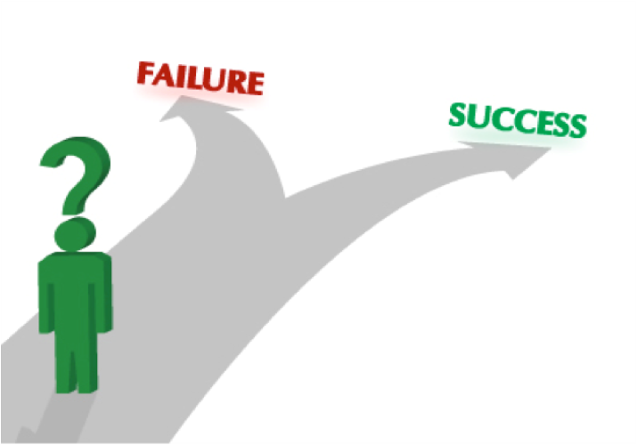
Feasibility Analysis

Slide 10


Technical Feasibility
Tech Stack
Tried and true
Maintenance phase hand-off
User Experience
myUMBC and Peoplesoft
High familiarity with web-based tools
Project Size
Functionality
Output of algorithm
Simple administrator interface
5-6 person development team
Can finish project in a semester

Slide 11

Economic Feasibility
Summary
The economic feasibility assessment of the academic pathway optimization tool provides a granular understanding of how each individual cost will be in consideration on how this project will be built in terms of financials and economic budget.
Assumptions
6-8 Person development team on a full time contract position over a year
These cost all pertain to the timeline of 1 year
Cost are being paid by sponsorship (UMBC)

Slide 12
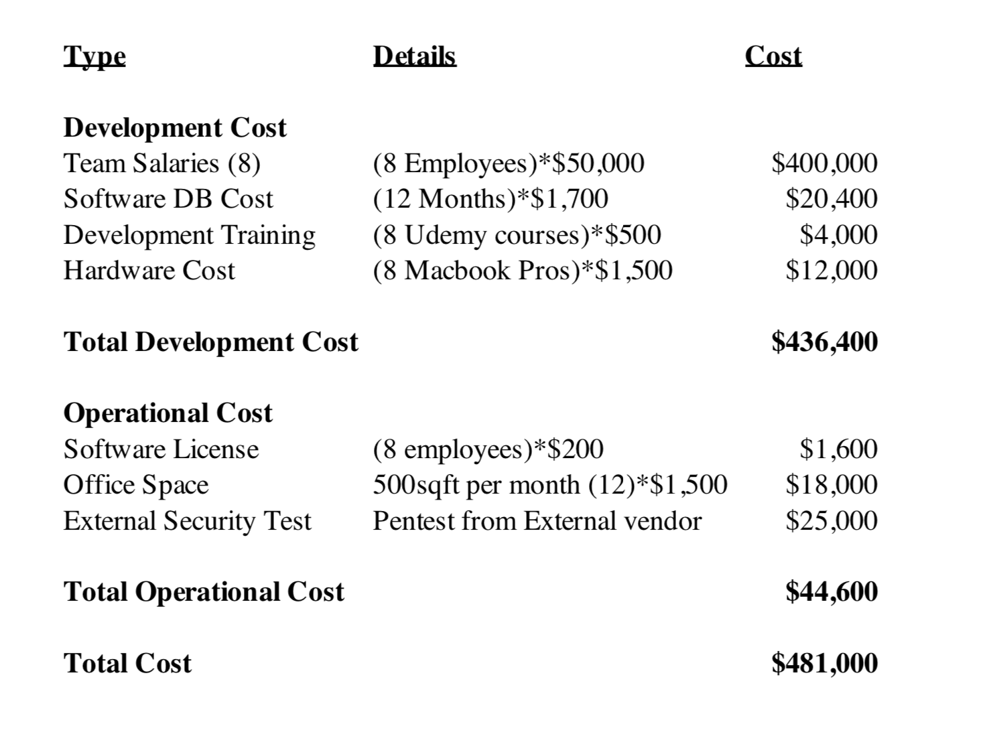
Development and Operational Cost

Slide 13

Organizational Feasibility
Management prowess: There is a wide spread of experience and skills throughout the team that makes this a reasonable undertaking. In addition, the size of the project is manageable given the amount of members participating in the project.

Slide 14
Organizational Feasibility
Resource Sufficiency: The real-world experience of members of the team is a large resource that provides large benefit. When identifying the most essential non-financial resources it can be seen that we have good sources of information when it comes to each aspect of application development and the project’s needs.

Slide 15
Organizational Feasibility Cont.
Strategic alignment: This project will help further UMBC’s goal of helping students graduate. Our software will help guide students in their choice of major through a series of specialized survey questions.
Target users: Incoming freshmen and other students unsure about what major they want to choose.

